Slide 1

Logic Devices – PLA and PAL
CS206
Dr. Anirban Sengupta

Slide 2
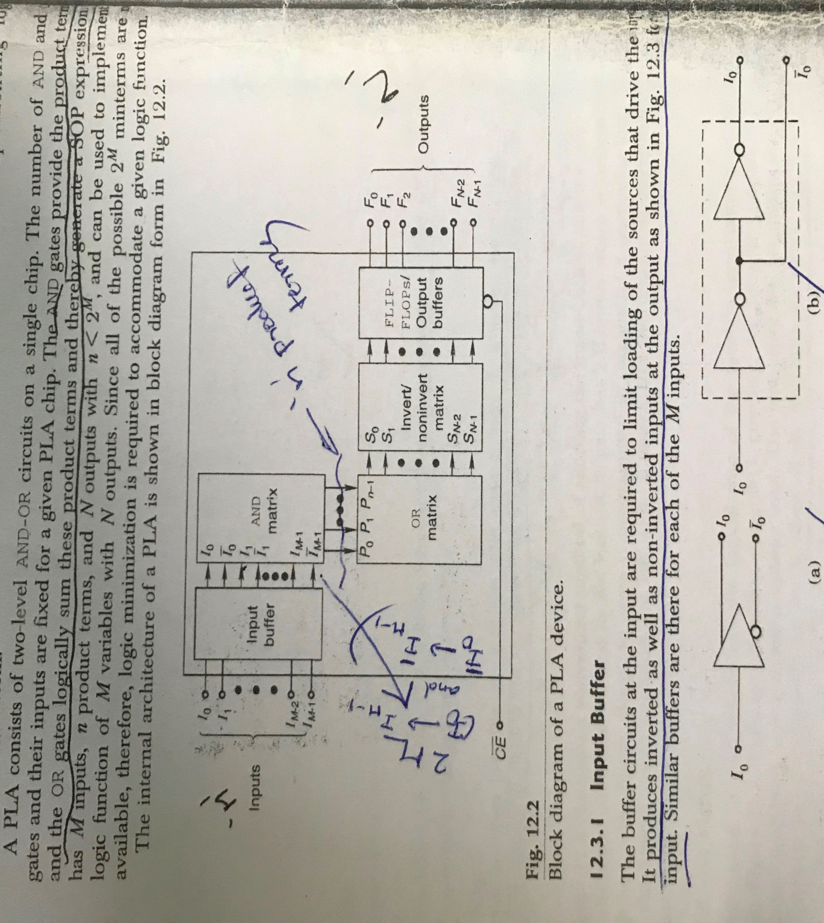
Programmable Logic Array (PLA)

Slide 3
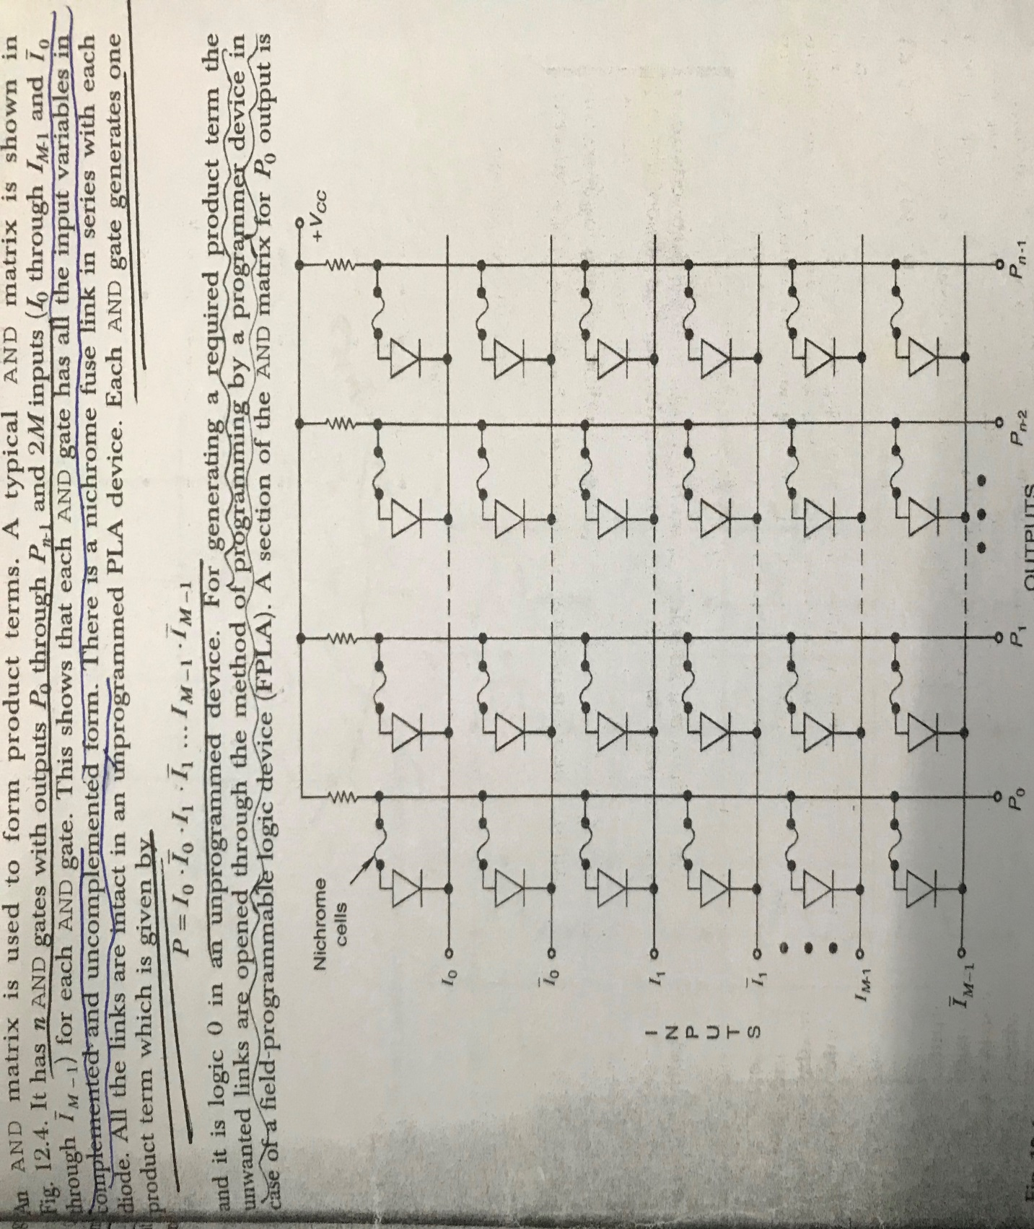
AND Matrix of PLA

Slide 4
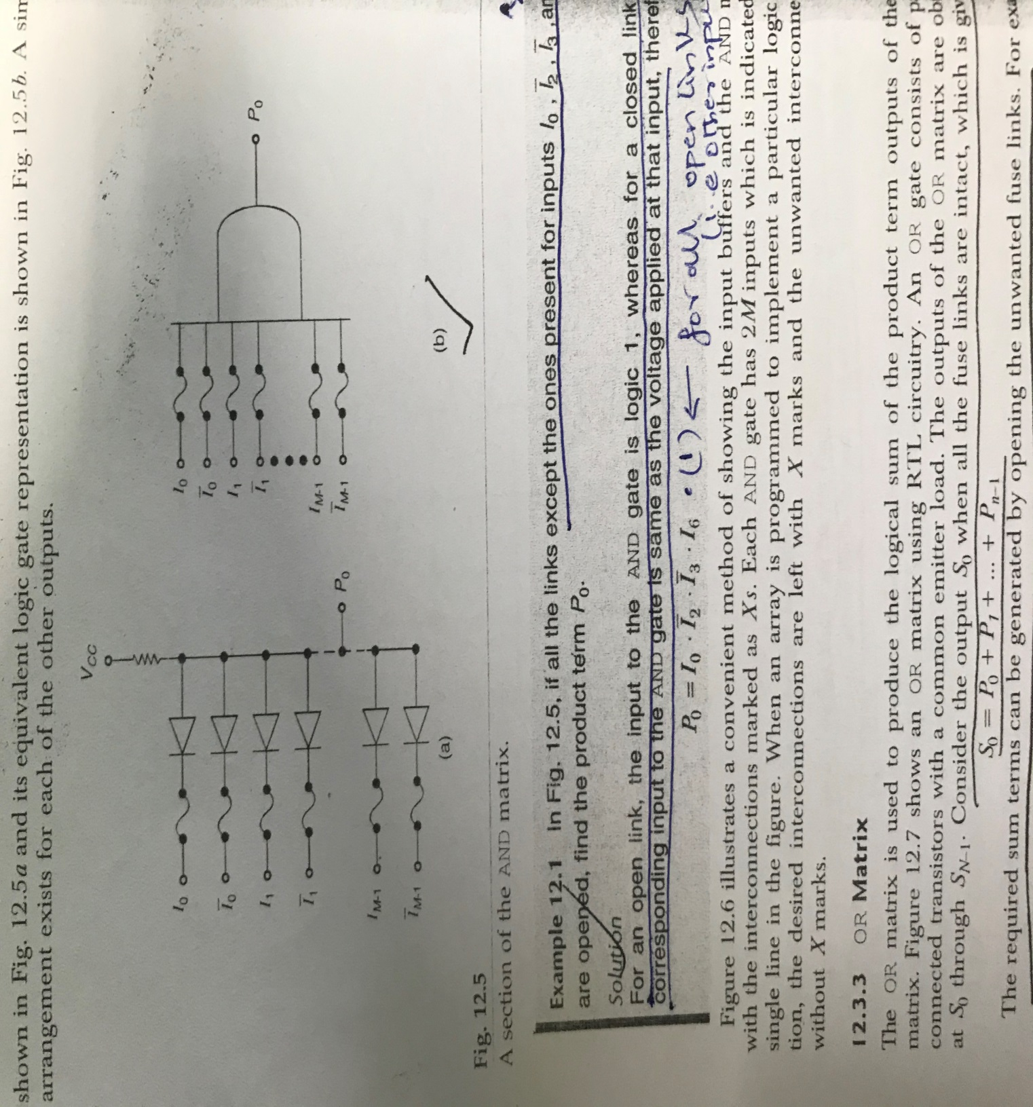
AND and OR Matrix of PLA

Slide 5
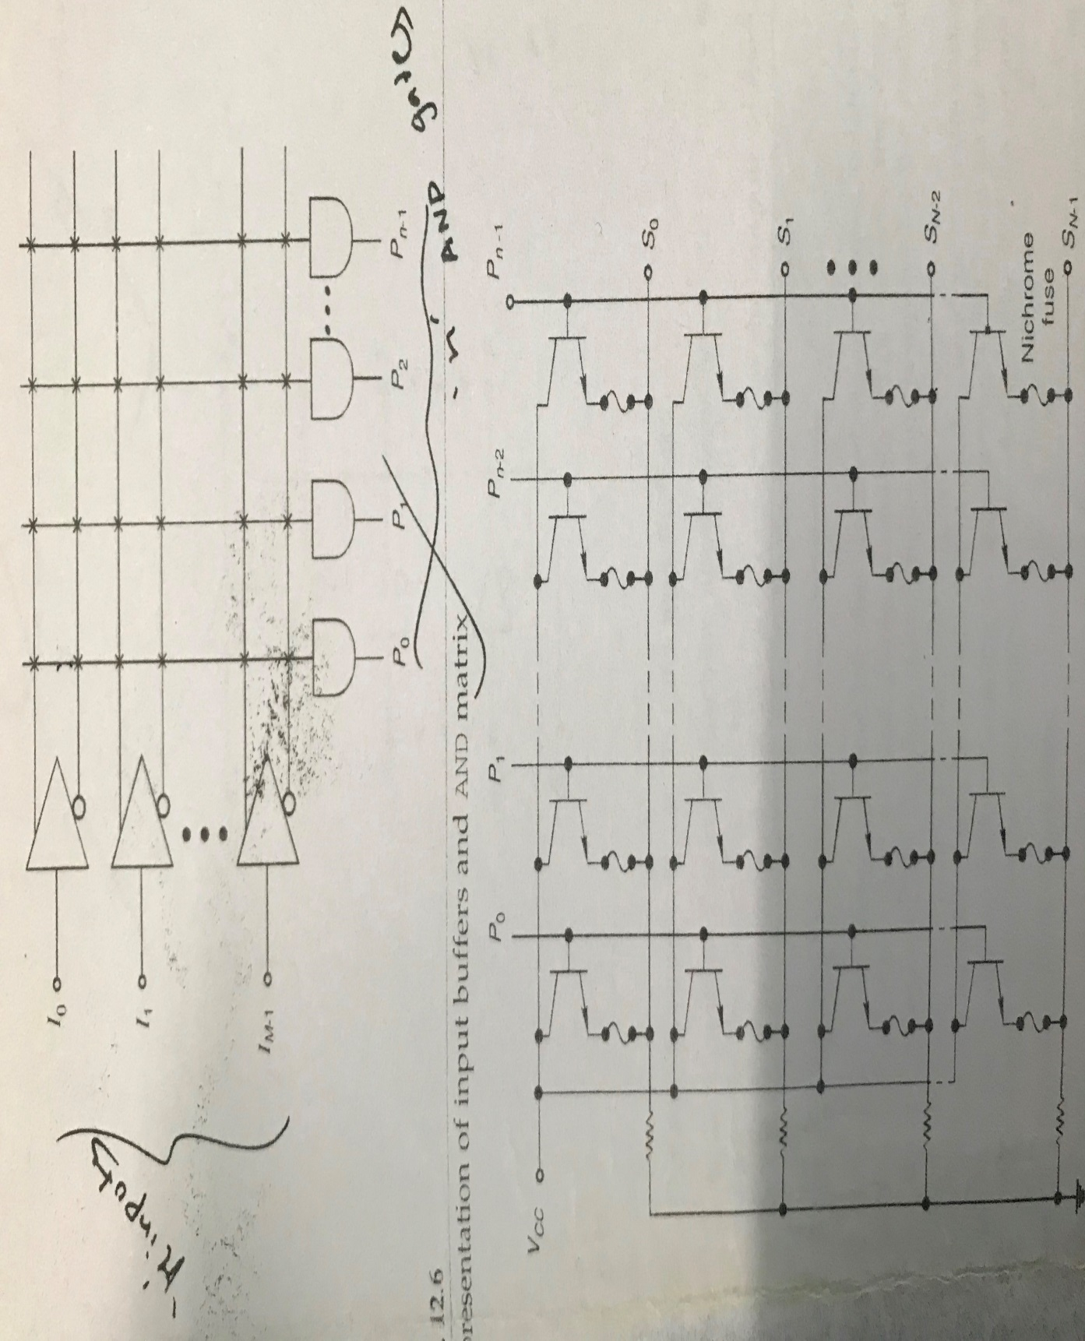
Input buffers and AND Matrix of PLA

Slide 6
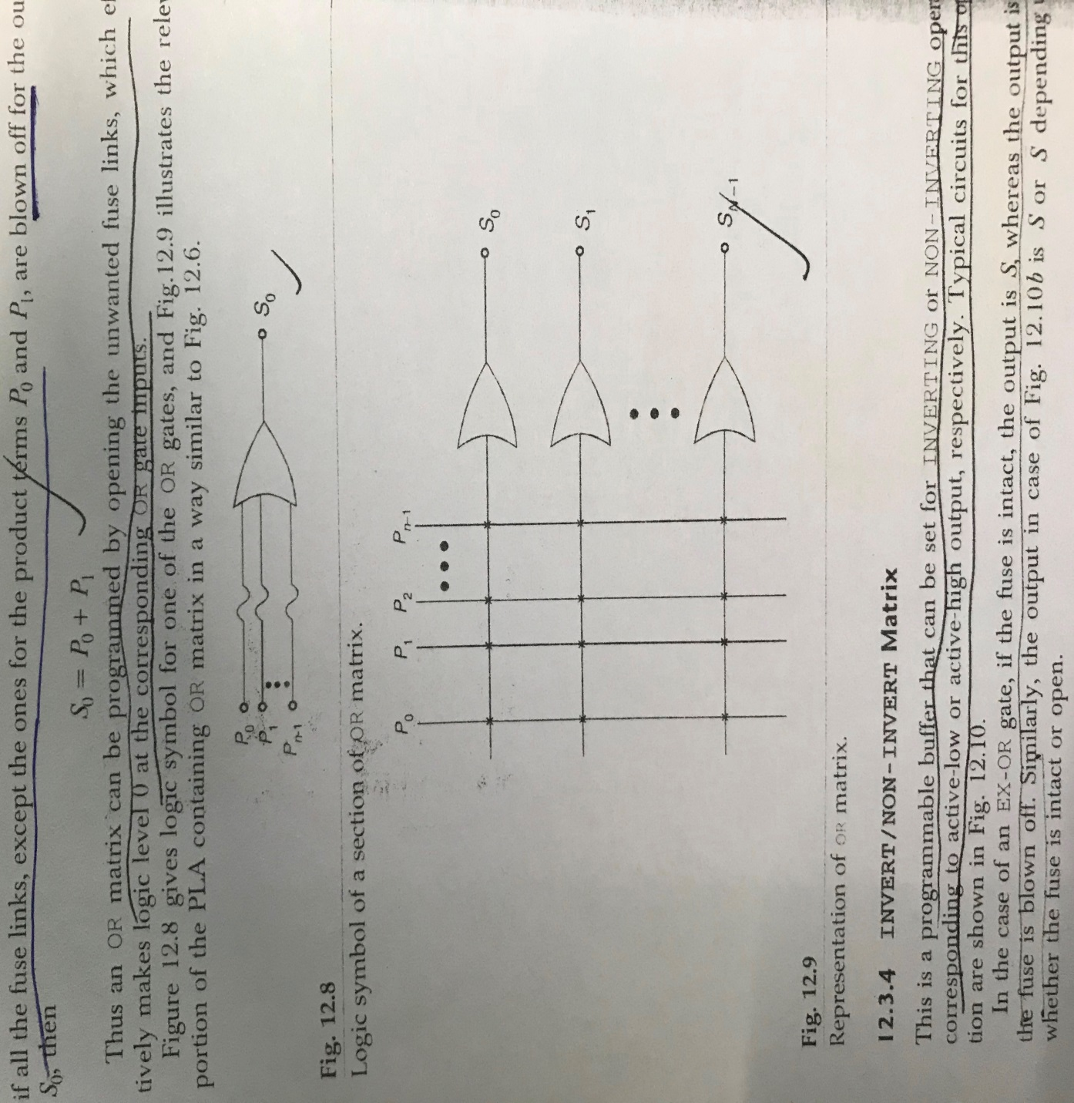
OR Matrix of PLA

Slide 7
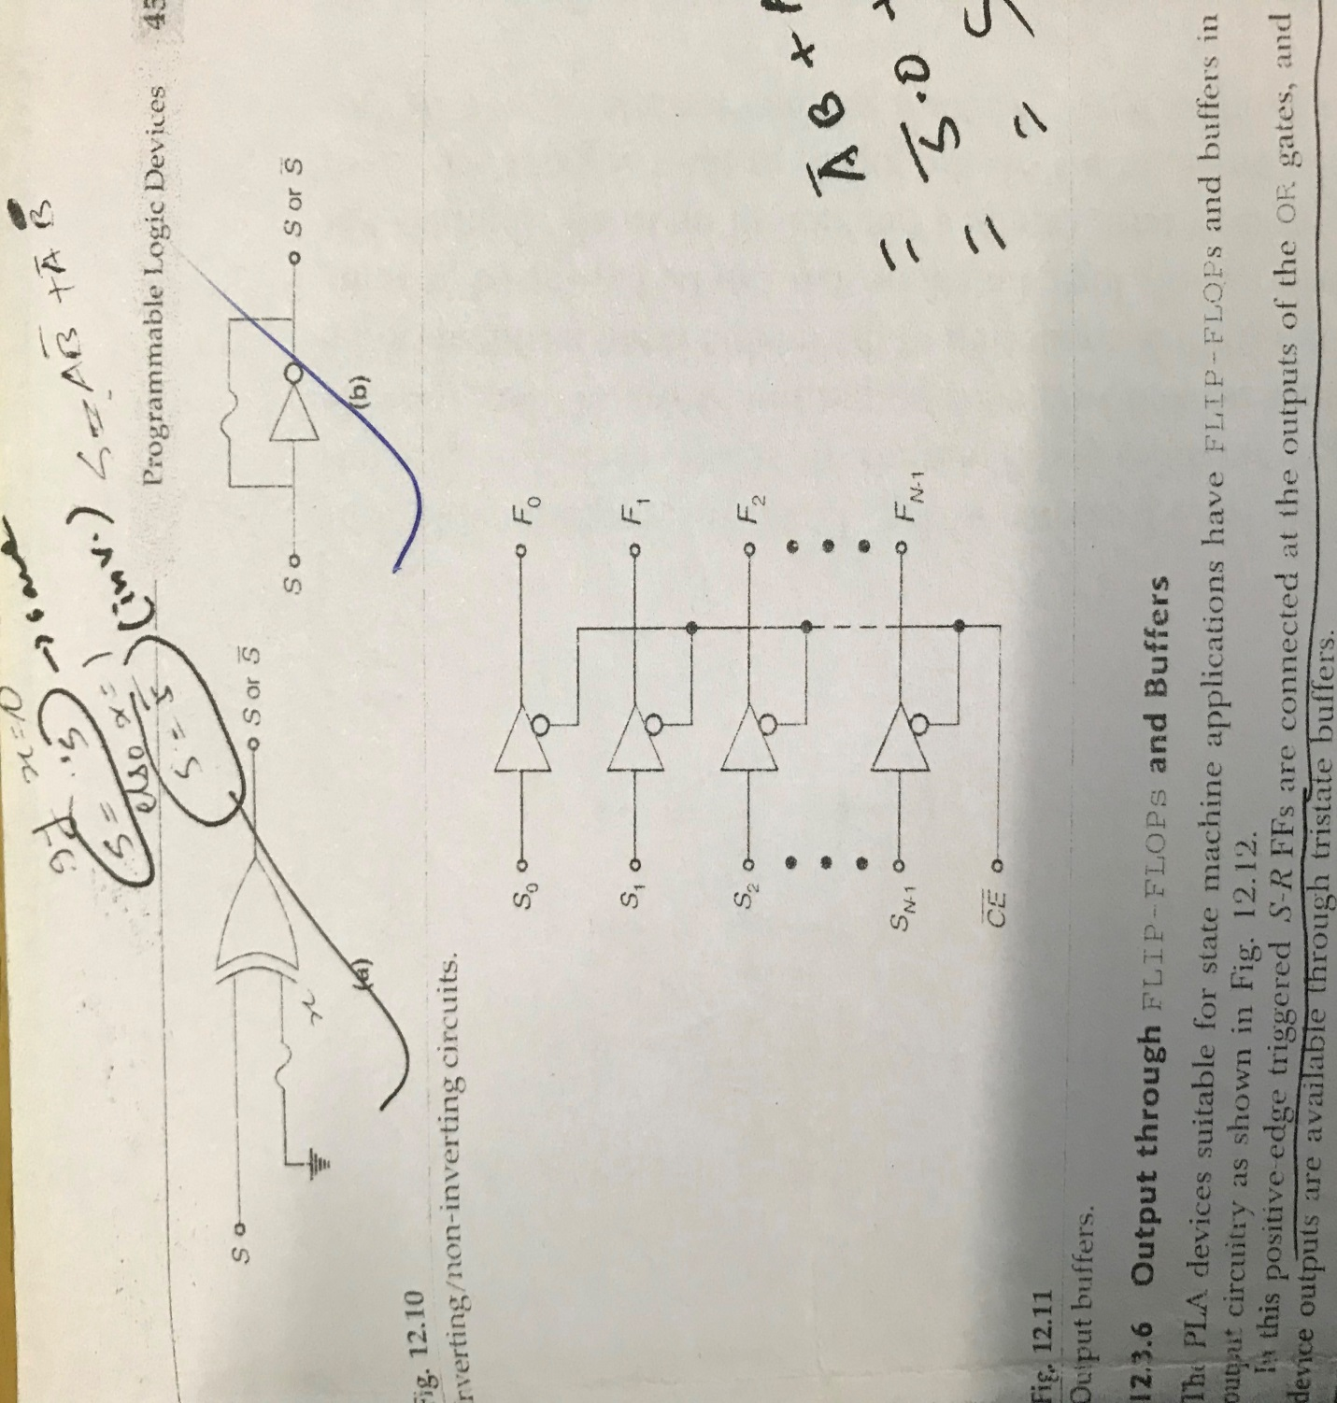
Inverting/Non-Inverting Circuits and O/P Buffers of PLA

Slide 8
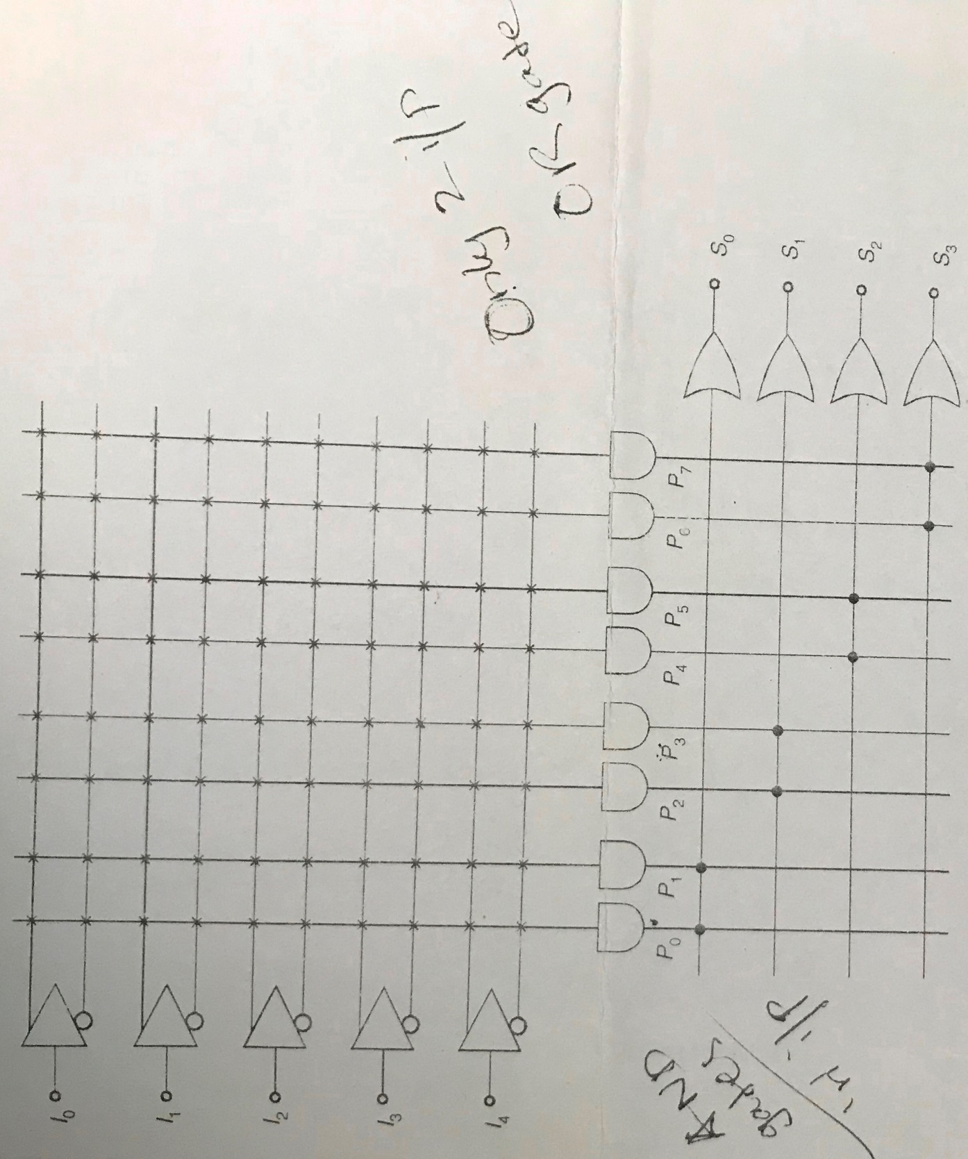
Programmable Array Logic (PAL)

Slide 9
PAL vs PLA
S.NO | PLA | PAL
1. | PLA stands for Programmable Logic Array. | While PAL stands for Programmable Array Logic.
2. | PLA speed is lower than PAL. | While PAL’s speed is higher than PLA.
3. | The complexity of PLA is high. | While PAL’s complexity is less.
4. | The cost of PLA is also high. | While the cost of PAL is low.
5. | Programmable Logic Array is less available. | While Programmable Array Logic is more available than Programmable Logic Array.
6. | It is less used than PAL. | While it is more used than PLA.

Slide 10
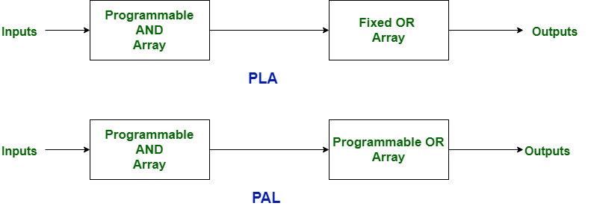
PAL vs PLA

Slide 11
Thanks

